Slide 1
A DigiHum approach to HistSocLing of Estonian
Peeter Tinits
25.07.2019
National Library of Latvia
BSSD2019

Slide 2
A case study in DH
Project:
What mechanisms are responsible for spelling standardization at the end of 19th century Estonian?
Data sources:
Anything relevant
Timeline:
PhD dissertation

Slide 3
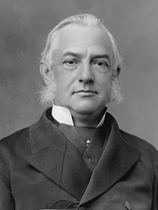
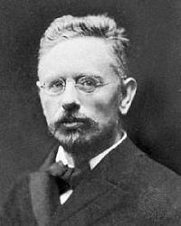
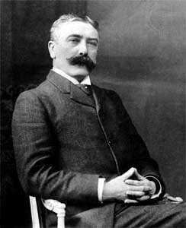
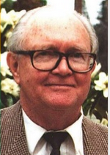
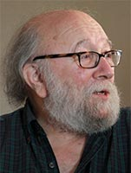

Some context
Language change: intentional or not
Müller (1861), Saussure (1916), Lass (1999):
„Intentional language change is peripheral to language“
Jesperson (1925), Ferguson (1989), Thomason (2007)
„Intentional language change is quite central to language phenomenon“

Slide 4
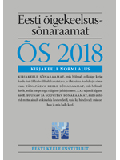
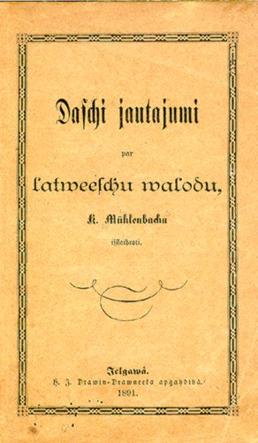
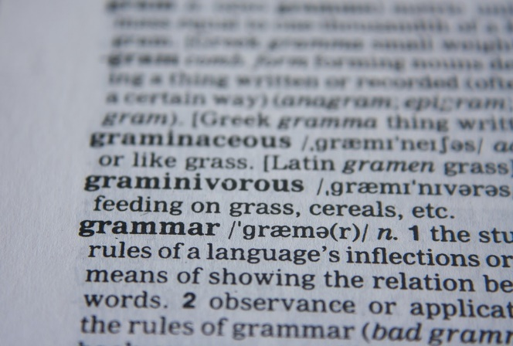
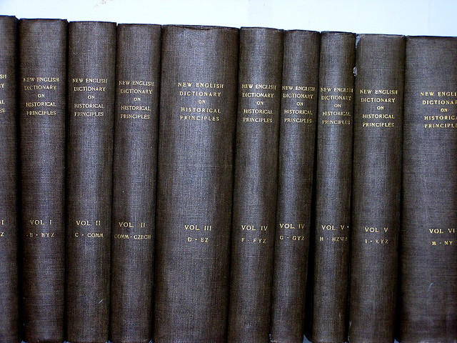
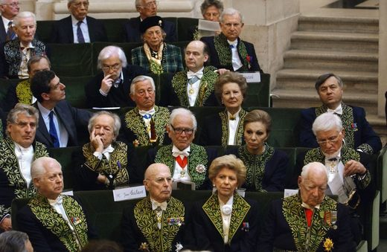
Written grammars as part of language
Language institutions and written norms have become normal for us.
Members of Académie Française (2019)

Slide 5
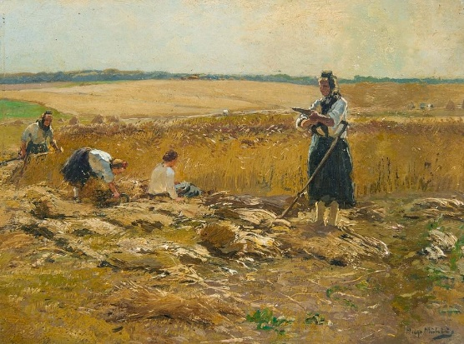
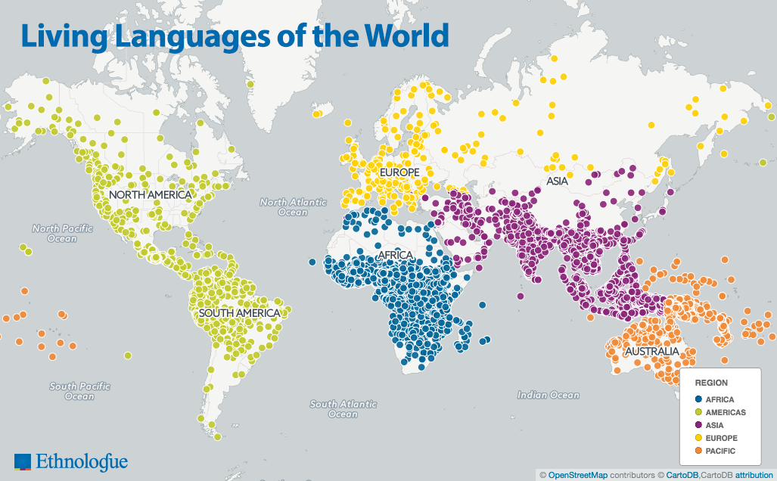
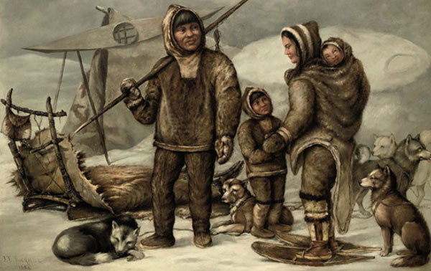
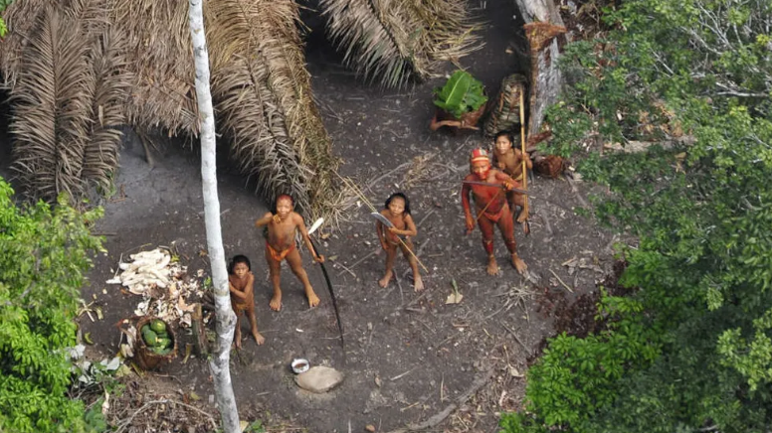
Languages without these grammars
Sociolinguistic research has shown that this is not always the case
Of ~7,000 languages, ~3,000 still are not written

Slide 6
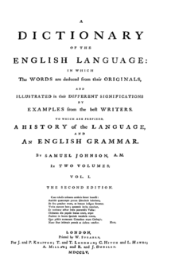
Even much writing is without standards
Shakespere, Shackspeare, Shakespear, Shakspere, Shaxspere, Shaxper, Shakspeare, Shackespeare, Shackspere, Shackespere
E.g. English became standardised from ~18c onwards
Shakespeare standardized from 1860 onwards only
Samuel Johnson (1750): Dictionary of English Language

Slide 7
Standardization research
Spelling practices vary by community.
Mechanisms and developments may depend on particular circumstances.
How did this take place for (some of) Estonian?

Slide 8
Estonian in the late 19c
From 1800-1900:
Peasant population becomes independent
Quick developments in education
Literacy from 20% to 95%
Intense travel and movement
Urbanization, railroads
Social and cultural modernization
Cultural production and identity
Strive to become a nation

Slide 9
Language standardization
One form instead of many (colour & color -> color)
How can this happen?
Talk like your neighbour
Follow a book
Survive longer
For mechanisms, we should follow the process

Slide 10
Finding the data
What is needed? What is available?

Slide 11
Texts
To study writing, we need texts:
Ideally from a variety of people
Education, dialect, profession
Sources:
Linguistic corpora
Digitized works

Slide 12
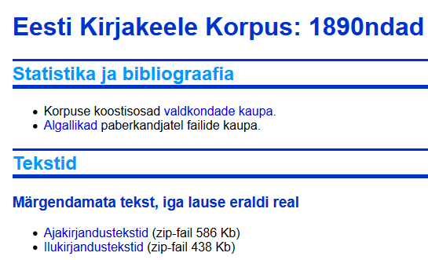
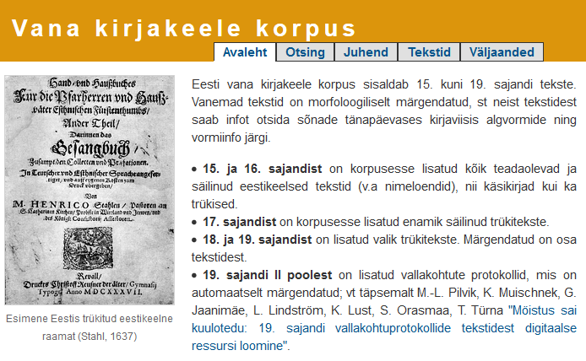
Linguistic corpora
Linguistic corpora are balanced collections of texts to facilitate language research.
For the period, there’s two:
Written Estonian Corpus
some 300 book snippets in 1890-1930
Old Written Estonian Corpus
all texts 1500-1700, some 50 texts from later
Small-ish and not much metadata

Slide 13
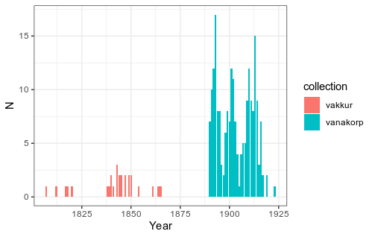
Linguistic corpora
Texts have high quality (though spelling was not in focus)
Relatively small though.

Slide 14
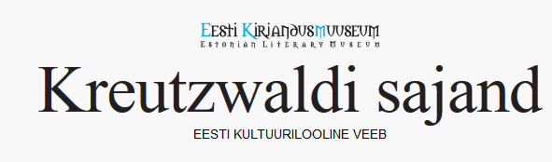





Digitized texts
For the past 20-30 years, a huge number of texts have been digitized.
In various collections and formats
With varying editing practices

Slide 15
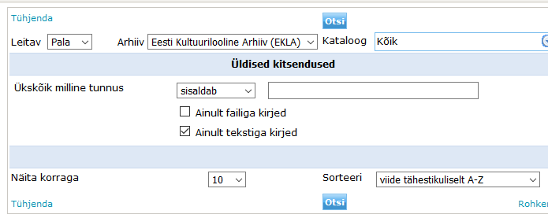
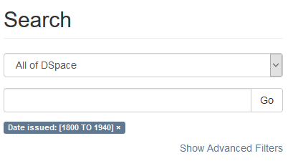
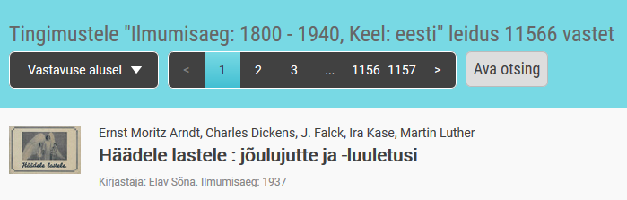
Examples of text collections
A variety of interfaces and access points
Usually text mining is not an option they consider
But don’t mind either

Slide 16
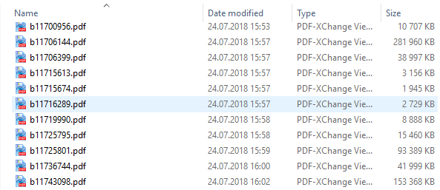
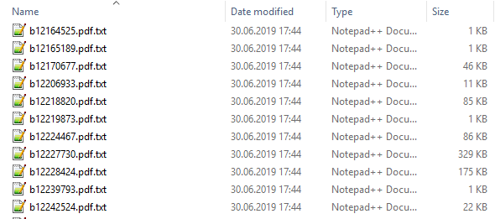
Getting the text
Files of different format into text

Slide 17
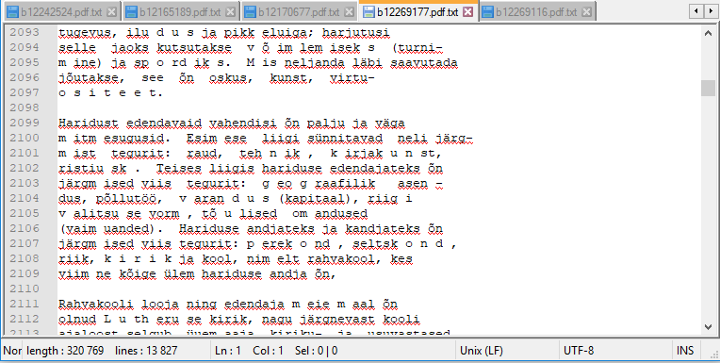
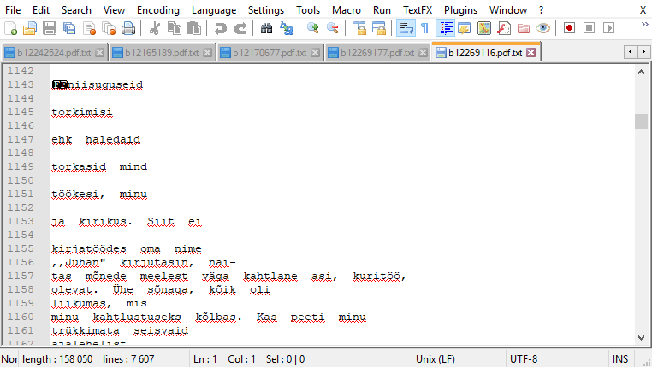
Getting the text
Finally, will have files that contain raw text
Quality will vary

Slide 18
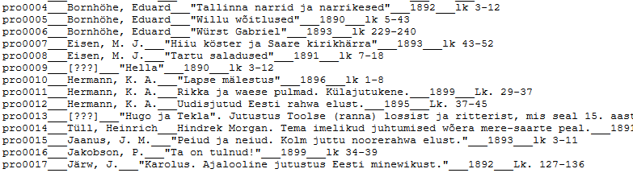
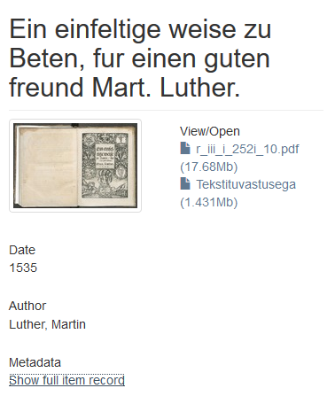
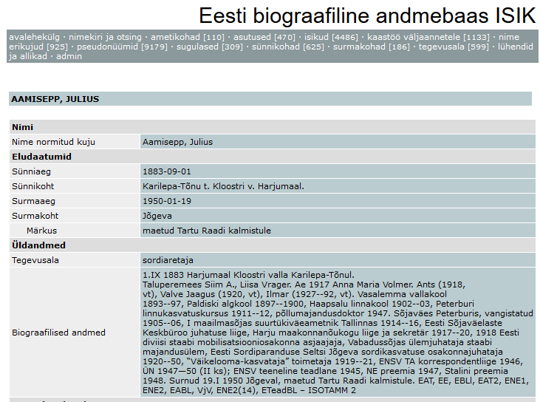
Metadata
Again in various formats
Ought to be collected

Slide 19

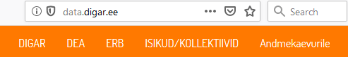
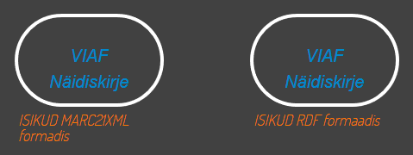
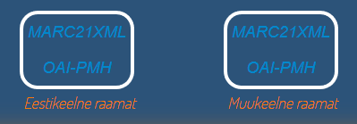
Metadata
General indexes (e.g. Estonian National Bibliography)
Estonian National Bibliography
Links to digitized text
Publication info
Person entry ids

Slide 20
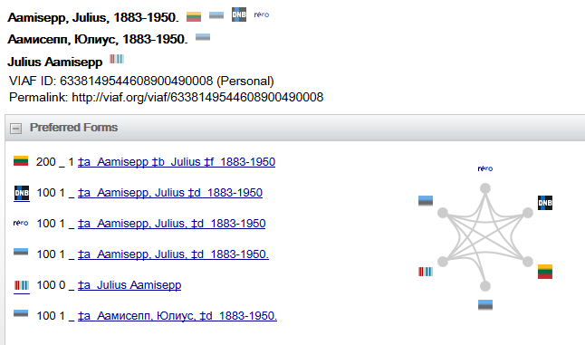
Collecting them all, linking them
Wikipedia
Person entry to linked data
Wikidata
Person entry ids
VIAF
Other libraries
Etc

Slide 21
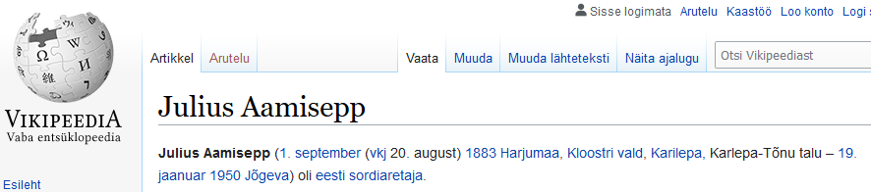
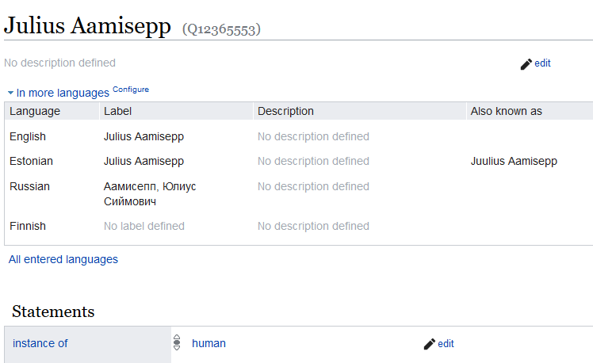
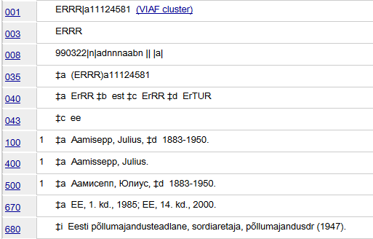
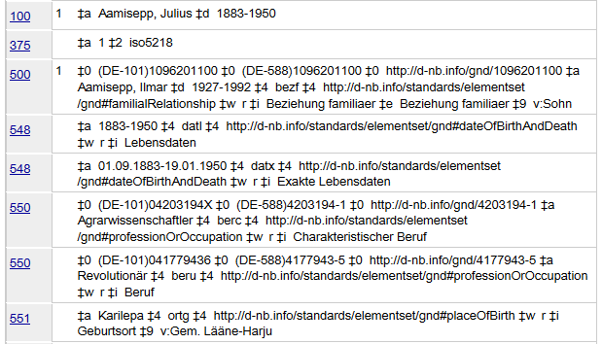
Aggregating the data

Slide 22
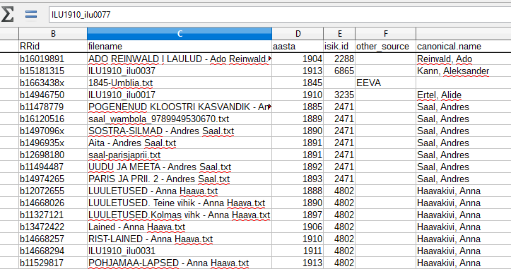
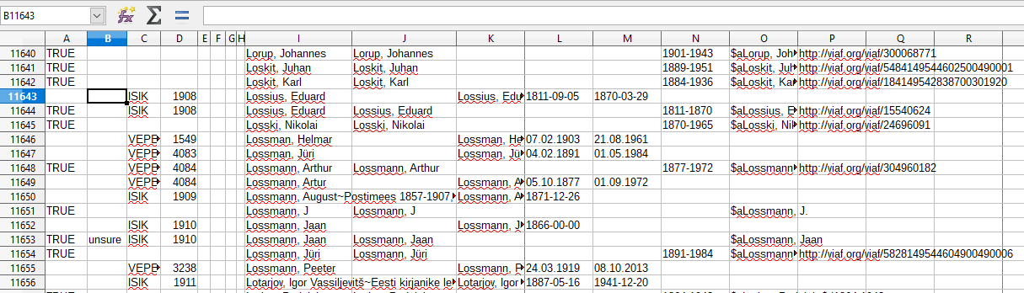
Manual linking
Manual linking

Slide 23
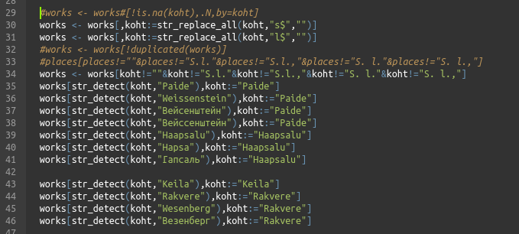
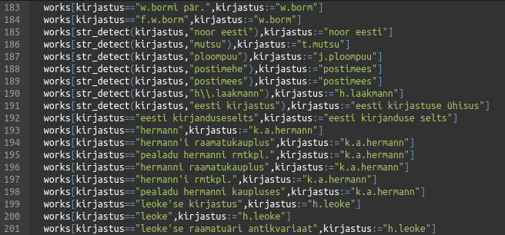
Harmonization
For archival puproses, accuracy is key.
For analysis, data harmonization is often needed.

Slide 24
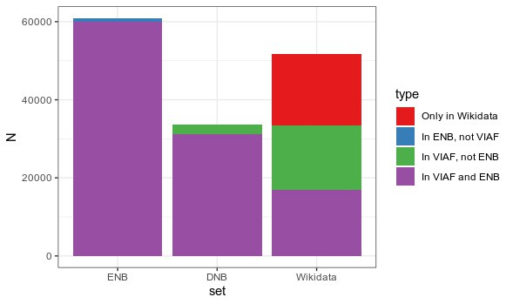
Results of linking
Linkability of archives

Slide 25
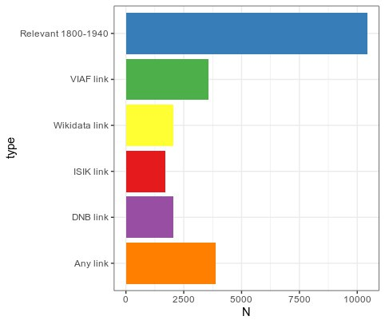
Results of linking
Linked author metainformation

Slide 26
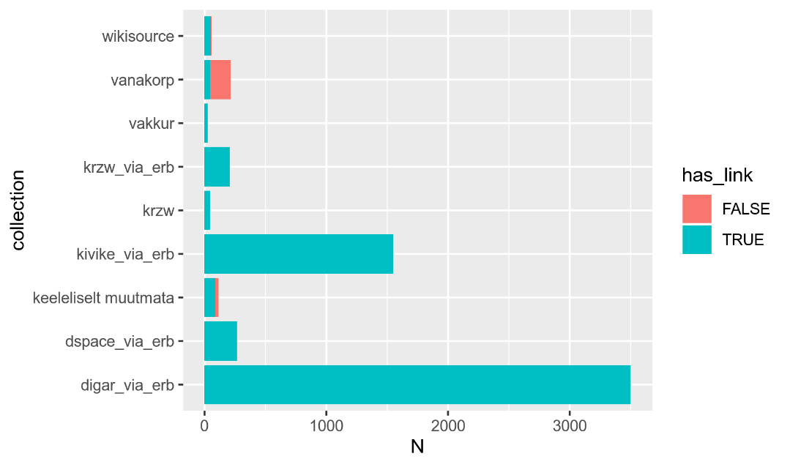
Results of text collection
5132 texts total, of 4186 unique publications

Slide 27
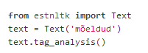
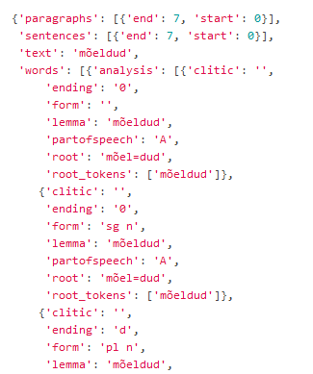
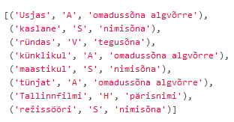
Processing the corpus
Raw texts can be processed
Lemmatize, POS-tag etc (used Python EstNLTK)

Slide 28
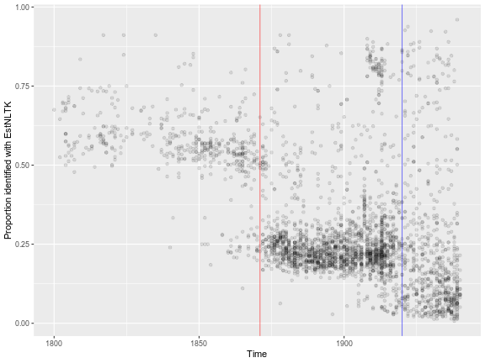
Results of the corpus
NLP success rate over time

Slide 29
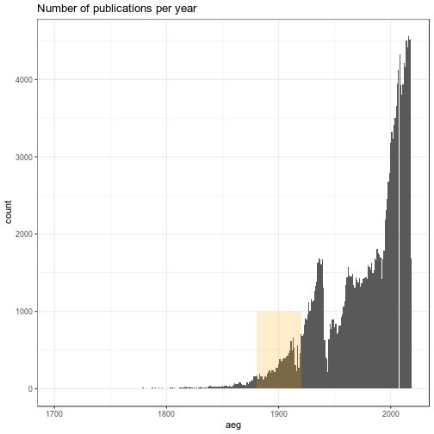
The published texts

Slide 30
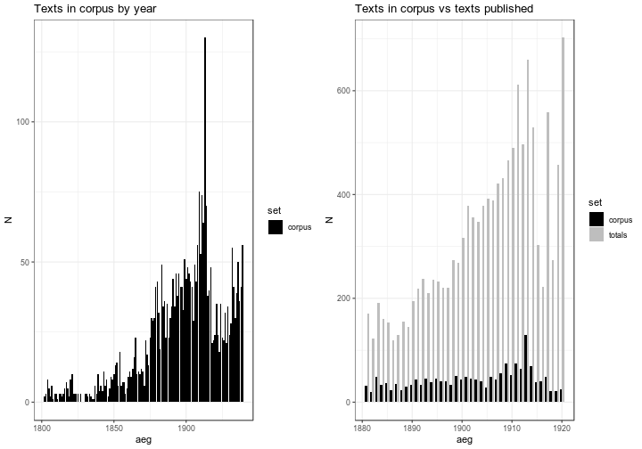
Representativeness

Slide 31


Publishing industry
More authors and open genres

Slide 32


Slide 33

A few cities dominate
MAKE PLOT

Slide 34

In corpus
s

Slide 35

Publishers
Top publishers (harmonized)

Slide 36

Publishers
Top publishers (harmonized) within corpus

Slide 37

Authors
Top authors (harmonized) within corpus

Slide 38
Other types of data
There is a lot of relevant scholarship.
Just thinking about it in terms of „data“ is new.
Needs creativity in finding and utilizing the data

Slide 39






Biographic data
Assemble life histories
from various sources

Slide 40

Placename locations

Slide 41

Birthplaces of writers
Some birthplaces of writers in corpus

Slide 42

Birthplaces by decade
Notes:
https://peetertinits.github.io/slides/plots/authorbirths.html

Slide 43

Education by decade
Public elementary school network in 1851

Slide 44

Education by decade
Public elementary school network in 1851
Public elementary school network in 1881

Slide 45

Life histories of writers
Notes:
https://peetertinits.github.io/slides/EDHC2018/prese_EDHC_2018.html#45

Slide 46



Demographic data
Censuses and analyses

Slide 47


Dialect geography

Slide 48

Dialect predicted values

Slide 49

Dialect compositions in cities

Slide 50


Migration and dialects

Slide 51
Getting to research
Operationalizing the question

Slide 52
Making the study
Specify the measured variables
Measure in suitable texts
Combine with metadata
Check the mechanisms
Notes:
Other datasets
Dialects & demography
Biography
Operationalizing the questions
Influence of prescription?
Who were the leaders, followers?

Slide 53
Variants and variation
A set of variables:
w / v – wabariik, vabariik
ää / ea – hää, hea; sääl, seal
üi / üü – nüid, nüüd
herra / härra
naine / naene
om / on
Fairly common in frequency
Have interesting variation in 1880-1920

Slide 54

Variants and variation

Slide 55

Study on particular variants

Slide 56

Average trends

Slide 57


Language prescription
Historian’s overviews
Overview of proposed norms in 1909 (Raag 2008)

Slide 58

Language prescription
Prescriptive events on the timeline
Blue (suggested norm towards 1)
Red (suggested norm towards 1)

Slide 59

Language prescription
Prescriptive events align very well with trends in usage.
=> at least some degree of prescriptive influence.

Slide 60

Language prescription

Slide 61
Mechanisms of standardization
Influences on language usage
Home dialect
Everyday language use
Education
Prescription
Etc
What made a suggestion successful?
Generational change vs individual change?

Slide 62

Phases of change
Looking at the aftermath of prescriptive events
Blue (suggested norm towards 1)
Red (suggested norm towards 1)

Slide 63

Simple tendencies in data
Significant predictors (logistic regression)
Model does not include dialect info

Slide 64

Simple tendencies in data
Significant predictors (logistic regression)
Model does not include dialect info

Slide 65

Simple tendencies in data
Significant predictors (logistic regression)
Model includes dialect info

Slide 66

Simple tendencies in data
Significant predictors (logistic regression)
Model includes dialect info

Slide 67

sa

Slide 68

s

Slide 69



A basic overview
Significant factors across all phases
Top (no dialect info), bottom (with dialect info)

Slide 70
Study conclusions
Main hypothesis (late 19c Estonian):
Spontaneous changes align with an influx of new authors
Prescriptive events line up clearly with trends
Some generational influence apparent: successful changes are led by young and large cities.
Study generally:
Data is everywhere and has not been collected
Already „first look“ at it can give insights
Thinking in terms of data also adds to theory

Slide 71
General discussion
80% of DH research is finding the data and getting it ready
Manual + technological work
Good-enough solutions for current tasks
Open collections can have a variety of uses
Difficult to predict
Also by-products of research can be useful
Databases & processing
Visualizations & understanding

Slide 72
Some advice/thoughts
Start & stay open, document everything!
Think how your current work fits to the whole project
Work with manageable chunks and fit them in right away
Don’t worry about lack of skills beforehand, but consult specialists!
Usually your problems are not new and have solutions.
However working with „data“ is new to humanities so you may need to step outside your institute/department.

Slide 73
Interactive plot links
https://peetertinits.github.io/slides/DH-labs-2019/prese_DH-lab_2019.html#14
https://peetertinits.github.io/slides/EDHC2018/prese_EDHC_2018.html#45
https://peetertinits.github.io/slides/EDHC2018/prese_EDHC_2018.html#50
https://peetertinits.github.io/slides/plots/authorbirths.html
https://peetertinits.github.io/slides/plots/samamaakond.html

